Slide 1
Java-Based Password Management System
"A Simple Yet Secure Command-Line Based User Authentication Framework"

Slide 2
Java-Based Password Management System
"A Simple Yet Secure Command-Line Based User Authentication Framework"

Slide 3
TEAM MEMBERS
INTRODUCTION
GROUP NO | BATCH | ROLL NUMBER | STUDENT NAME
G05 | S2 | 45 | Shubham Sandeep Shelar
 |  | 34 | Santosh Manoj Gupta
 |  | 35 | Nikhil Sidram Sabban
 |  | 36 | Ruturaj Vitthal Bhoi
In today’s digital landscape, safeguarding user credentials is more important than ever. With the rise in online services and applications, having a secure and efficient authentication system is no longer optional—it's a necessity. This project introduces a Java-based Password Management System designed to handle essential user operations such as sign-up, login, password updates, and logout.
In the digital age, secure password management is critical for protecting user data in any application.
This Java-based system provides basic features like sign-up, login, password update, and logout using a command-line interface.
It demonstrates core Object-Oriented Programming principles, making it a great learning project for beginners.

Slide 4
INTRODUCTION
OBJECTIVE
In today’s digital landscape, safeguarding user credentials is more important than ever. With the rise in online services and applications, having a secure and efficient authentication system is no longer optional—it's a necessity. This project introduces a Java-based Password Management System designed to handle essential user operations such as sign-up, login, password updates, and logout.
In the digital age, secure password management is critical for protecting user data in any application.
This Java-based system provides basic features like sign-up, login, password update, and logout using a command-line interface.
It demonstrates core Object-Oriented Programming principles, making it a great learning project for beginners.
Easy
To create a lightweight, in-memory system suitable for learning authentication and data handling.
Functionable
To provide basic functionalities like user registration, login, password updates, and user listing.
Simple
To build a simple password management system using core Java and Object-Oriented Programming (OOP) principles.

Slide 5
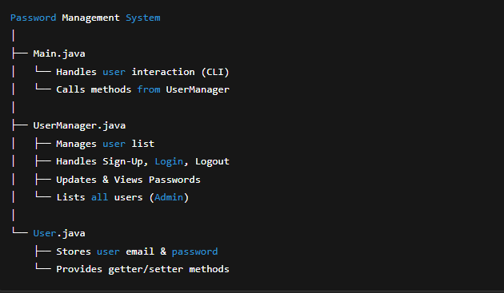
OBJECTIVE
SYSTEM ARCHITECTURE
Simple
Functionable
Easy
To build a simple password management system using core Java and Object-Oriented Programming (OOP) principles.
To provide basic functionalities like user registration, login, password updates, and user listing.
To create a lightweight, in-memory system suitable for learning authentication and data handling.

Slide 6
SYSTEM ARCHITECTURE
WORKING OF THE SYSTEM
Step 4
See Users
Admin can list all users; data is managed in-memory using Java classes.
Step 3
04
View/Update
After login, users can view or update passwords and logout.
Step 2
Email & Pass
Users can register by entering a valid email and strong password
Step 1
SignUp/Login
The program starts and displays a menu for Sign-Up, Login, and Exit.

Slide 7
WORKING OF THE SYSTEM
Java Concepts Used
Step 4
01
02
03
Step 3
See Users
Object-Oriented Programming (OOP): Classes, objects, encapsulation, abstraction.
Data Structures: Arrays used for storing user data in memory.
Exception Handling: Validates input and manages errors gracefully.
Step 2
View/Update
Admin can list all users; data is managed in-memory using Java classes.
Step 1
Email & Pass
After login, users can view or update passwords and logout.
SignUp/Login
Users can register by entering a valid email and strong password
04
05
06
The program starts and displays a menu for Sign-Up, Login, and Exit.
Control Structures: Conditional statements and loops for menu navigation.
Methods & Constructors: Used for logic reuse and object initialization.
Access Modifiers: private, public for encapsulation of data.

Slide 8
Java Concepts Used
01
02
03
04
05
06
Object-Oriented Programming (OOP): Classes, objects, encapsulation, abstraction.
Data Structures: Arrays used for storing user data in memory.
Exception Handling: Validates input and manages errors gracefully.
Thank You :)
Control Structures: Conditional statements and loops for menu navigation.
Methods & Constructors: Used for logic reuse and object initialization.
Access Modifiers: private, public for encapsulation of data.

Slide 9
Thank You :)

